Slide 1
HUMAN RESOURCES Employee Attrition
Presented by: Aurelia Tambur
Last updated: July 21st, 2023

Slide 2
Table of Contents
Description and background of analysis
Purpose statement (What are we talking about ?)
Tell the Story ( with Data)
Conclusion
Appendix

Slide 3
Description and background of analysis

Slide 4
Description
The key to success in any organization is attracting and retaining top talent.
As an HR analyst one of the key task is to determine which factors keep employees at the company and which prompt others to leave.
Given in the data is a set of data points on the employees who are either currently working within the company or have resigned.
The objective is to identify and improve these factors to prevent loss of good people.

Slide 5
What are we talking about ?

Slide 6
The business goal
Identify if employee attrition is influenced by such factors as department, salary, overtime, job satisfaction, and/or traveling.

Slide 7
Subquestions
When they are leaving ?
Who is leaving the organization ?
Why they are leaving ?
Share an overview of attrition and retention rate and demographics (workforce characteristics):
age
gender
department
to get a picture about the company.
The fact, after how many years of service do employees leave can tell us what periods are most affected by attrition.
What factors can organizations change to prevent the loss of good people by adopting effective management .

Slide 8

Meet The Data
Data contains survey results of 1470 employees who are either currently working within the company or have resigned.
It includes details about their age, salary, education, satisfaction scores, marital status, years of working etc.
It is available on:
Employee Attrition | Kaggle

Slide 9
Present data

Slide 10
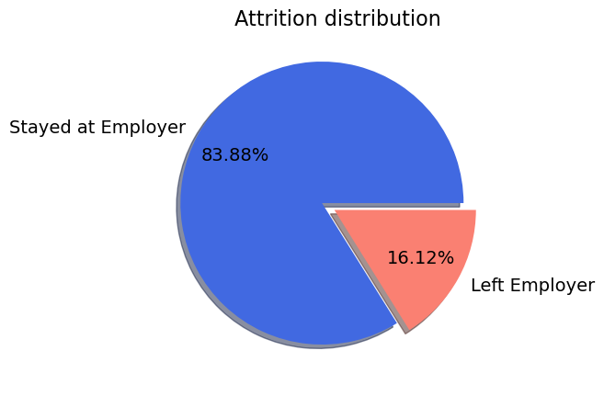
Attrition and Retention Rate
Retention rate
To make a conclusion about them we should compare them with historical metrics of organization.
Attrition rate
Notes:
Attrition rate is a metric, defined by: No of employees that left during a specified period/ Total No. of employees for a particular period *100
Retention Rate: The opposite of attrition rate in that you divide the number of employees who remained in your organization over a given period by the number of total employees.

Slide 11
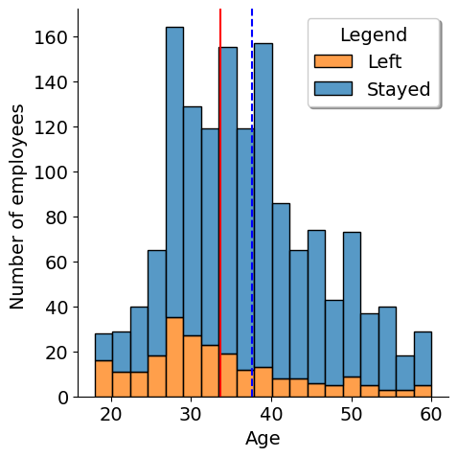
Demographics: Age
Attrition is decreasing with aging.
It is increased until 40 y. o.
Notes:
mean_age_attrition= 33 y.o.
Mean_age_stayed = 37 y.o.
First affected age group is 18-30 years old in 47 % from those who left.
Second affected age group is 31-40 years old in 36 %.
Third affected is 41-50 y.o. – 14 %
Fourth is 51-60 y.o. – 8%

Slide 12
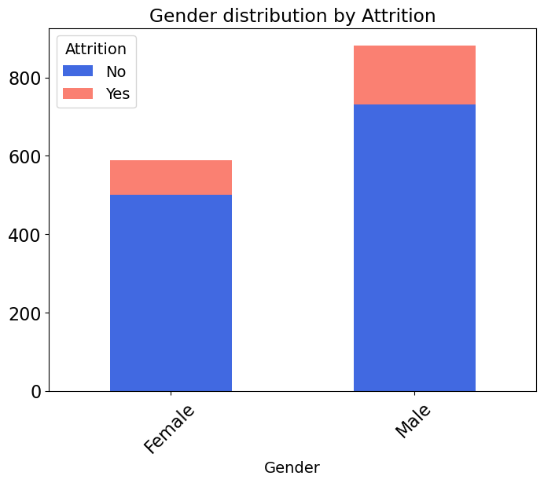
Demographics: Gender
17 %
Ratio female to male employee is 1:1,5
14 %
Male left the company more than female by 3 %

Slide 13
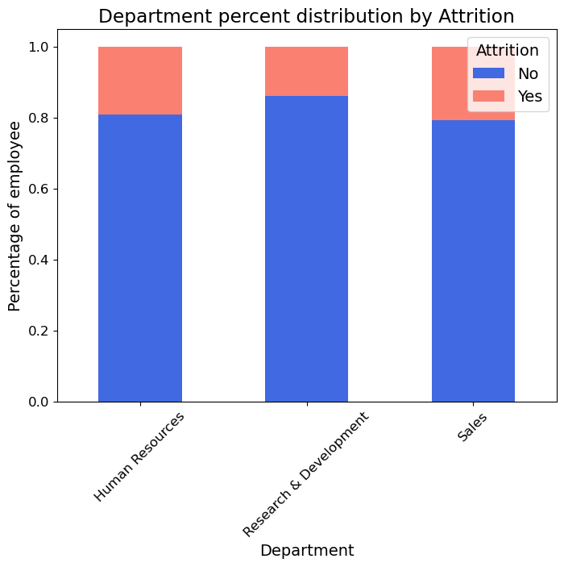
Demographics: Department
Sales is the most affected -20% left
Human Resources- the second, 19% left
Research & Development- the least, 13% left
Notes:
1. Attrition rate of the organization is 16 % for the survey period.
It is more present until age of 40, for male in 3 % more than female, in Sales Department.

Slide 14
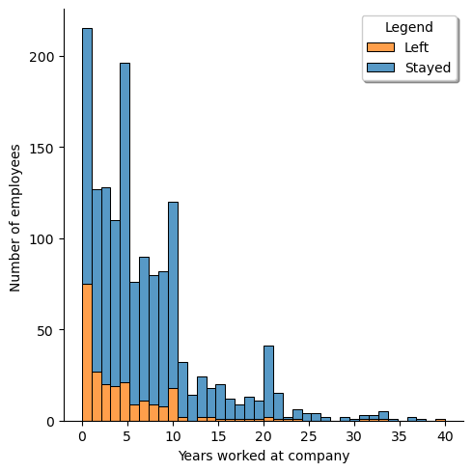
After how many years of service attrition happen ?
92 % of those who leave do it after 10 years of service.
Notes:
Employees are leaving after 10 year of service in 92% of cases.

Slide 15
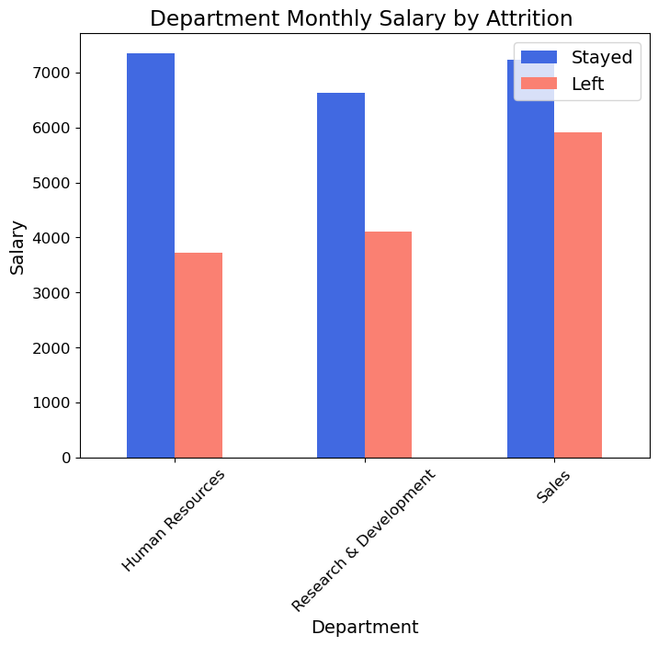
Salary
From all departments employees who left had a smaller monthly salary than those who stayed.
Notes:
Employees who left had a smaller monthly salary in all departments

Slide 16
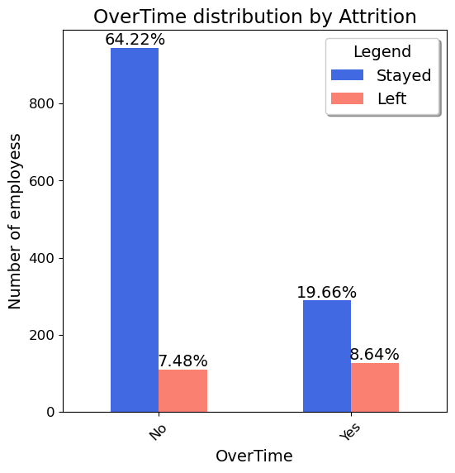
Overtime
More employees leave in case of OverTime working.
!!! It is not causation, there is only correlation.
The correlation is weak.
Notes:
Correlation-0.25 between OverTime and Attrition--> more employees worked over time, higher chances to leave the company.

Slide 17
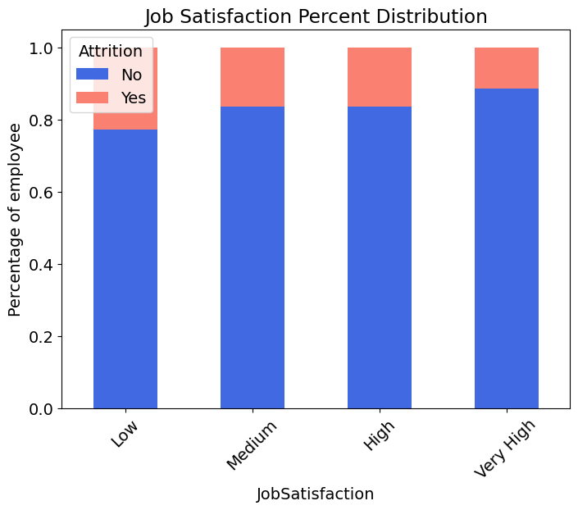
Job Satisfaction
Attrition is decreasing with higher score of job satisfaction.

Slide 18
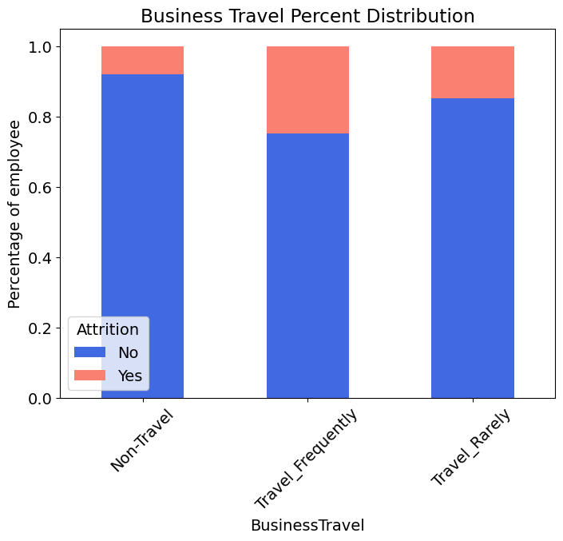
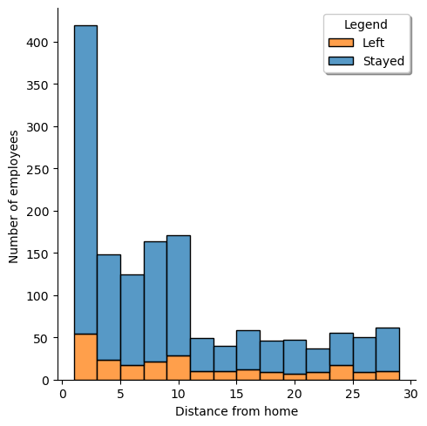
Traveling
Most frequently employees that have business travel leave the company.
There is no correlation between distance from home and attrition.
Notes:
39.24 % of employees who left have a distance more than 10, but 60% left -with distance less than 10.

Slide 19
Conclusion

Slide 20
Conclusions
1. Attrition rate of the organization is 16 % for the survey period.
It is more present until age of 40, higher for male in 3 % more than female.
2. Sales Department is the most affected with 20 % of leaving.
3. Employees are leaving after 10 year of service in 92% of cases.
4. Employees who leave have a smaller monthly salary in all departments, and/or have over time working.
5. Attrition is decreasing with higher score of job satisfaction.
6. Most frequently employees that have business travel leave the company.

Slide 21
Recommendations
1.Make a historical analysis of organization’s metrics to get full picture.
Recruiting and maintaining younger employees.
2. Further analysis (make surveys) for Sales Department to detect factors that can lead to attrition and to improve it.
3. Take anonymous feedback from those who have worked more than10 years at the company to deeper understand the problems.
4. A better time management to not overload with work. Adjust the salary by quantity of work.
5. Further analysis (take surveys) to know what makes them more or less satisfied by job.
6. Make survey for target group of business travelers, to know what to improve to mitigate attrition.

Slide 22
The potential business customer
What was the duration of this survey ? Who performed the survey ? Is the survey unbiased ?
Does it include all the employees of the organization?
Does organization have other data analysis to interpret metrics ?
Do employees want stay over time? How over time is paid?
How those who have business travel are paid and what conditions do they have during travelling ?

Slide 23
Thank you !

Slide 24
Appendix

Slide 25
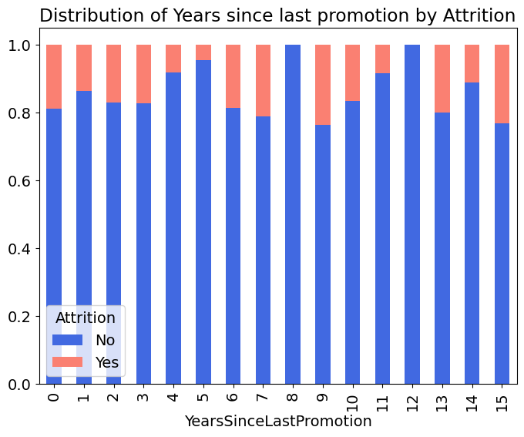
Data analysis was done in Python, using Pandas.
Basic variables where tested by:
-deleting duplicates,
-checking for null values,
-checking categorical and continuous values for abnormalities
-dropping columns with only one unique value: EmployeeCount (1), Over18 (Y), StandardHours (80)
Over hypothesis analyzed : Does promotion affect attrition?
The is no correlation between years since last promotion and attrition.
Employees left in different time periods since their last promotion.

Slide 26
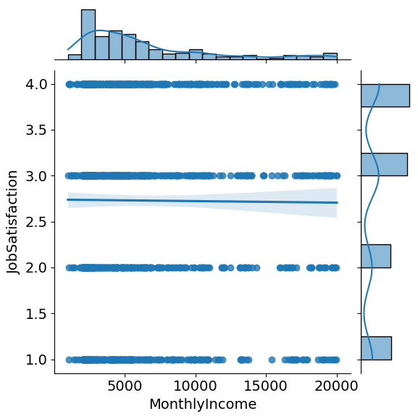
There is no correlation between monthly salary and job satisfaction.

